Slide 1
CHAPTER 5 part 1 DATA COMMUNICATION
Prepared by:Ahmed AL-Ashoor

Slide 2
Data communication
Is the facility to transfer data to remote locations quickly & conveniently , the data is transferred by means of a telecommunication network.

Slide 3
Elements of Data Communication
Four basic elements are needed for any communication system:-
1- Sender.
2- Medium.
3- Receiver.
4- Protocols.

Slide 4
Elements of Data Communication
1. Sender. The computer or device that is used for sending data is called sender, source or transmitter . In modern digital communication system, the source is usually a computer

Slide 5
Elements of Data Communication
2. Medium. The means through which data is sent from one location to another is called transmission medium.
If the receiver and transmitter are within a building, a wire connects them.

Slide 6
Elements of Data Communication
3. Receiver. The device or computer that receives the data is called receiver. The receiver can be a computer, printer or a fax machine

Slide 7
Elements of Data Communication
4. Protocols. There are rules under which data transmission takes place between sender and receiver. The data communication is used to transfer data from one computer to another ,They follow same communication protocols can communicate and exchange data.

Slide 8
Data Transmission
Data may be transfer from one device to another by means of some communication media.
The electromagnetic or light waves that transfer data
from one device to another device in encoded form are called signals.
Data transmissions across the network can occur in two forms i.e.:
(i) Analog signal.
(ii) Digital signal.

Slide 9
Data Transmission
Analog Signal. The transfer of data in the form of electrical signals or continuous waves is called analog signal or analog data transmission. An analog signal is measured in volts and its frequency is in hertz (Hz(.

Slide 10
Data Transmission
Advantages of Analog Signaling:-
1· Allows multiple transmissions across the cable.
2· Suffers less from attenuation.
Disadvantages of Analog Signaling:-
1· Suffers from electromagnetic interference (EMI).
2· Can only be transmitted in one direction without sophisticated equipment.

Slide 11
Data Transmission
Digital Signal
The transfer of data in the form of digit is called digital signal or digital data transmission. Digital signals consist of binary digits(0&1).
Electrical pulses are used to represent binary digits. Data transmission between computers is in the form of digital signals.

Slide 12
Data Transmission
Advantages of Digital Signaling:-
* Equipment is cheaper and simpler than analog equipment.
* Signals can be transmitted on a cable bidirectional.
* Digital signals suffer less from electromagnetic interference (EMI).
Disadvantages Digital Signaling:-
* Only one signal can be sent at a time.
* Digital signals suffer from attenuation

Slide 13
Modes of Data Communication
The manner in which data is transmitted from one location to another location is called ‘data transmission mode’.
There are three ways or modes for transmitting data from one location to another. These are:
(1) Simplex.
(2) Half duplex.
(3) Full duplex.

Slide 14
Modes of Data Communication
Simplex Mode:
In simplex mode, data is transmitted in only one direction. A terminal can only send data and cannot receive it or it can only receive data but cannot send it.
examples of simplex transmission: Speaker, radio and television

Slide 15
Modes of Data Communication
Simplex Mode:
Advantages of Simplex
•Cheapest communication method.
Disadvantage of Simplex
•Only allows for communication in one direction.

Slide 16
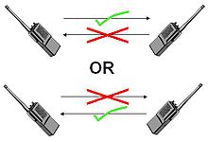
Modes of Data Communication
Half Duplex Mode:
In half duplex mode, data can be transmitted in both directions but only in one direction at a time. During any transmission, one is the transmitter and the other is receiver.
Wireless communication is an example of half duplex

Slide 17
Modes of Data Communication
Half Duplex Mode:
Advantages of Half Duplex
· Costs less than full duplex.
· Enables for two way communications.
Disadvantages of Half Duplex
· Costs more than simplex.
· Only one device can transmit at a time.
It is a slow mode for transmitting data because time wastes in switching directions

Slide 18
Modes of Data Communication
Full Duplex Mode:
In full mode, data can be transmitted in both directions simultaneously. It is a faster mode for transmitting data because no time wastes in switching
directions.
Example of full duplex is telephone set in which both the users can talk and listen at the same time.

Slide 19
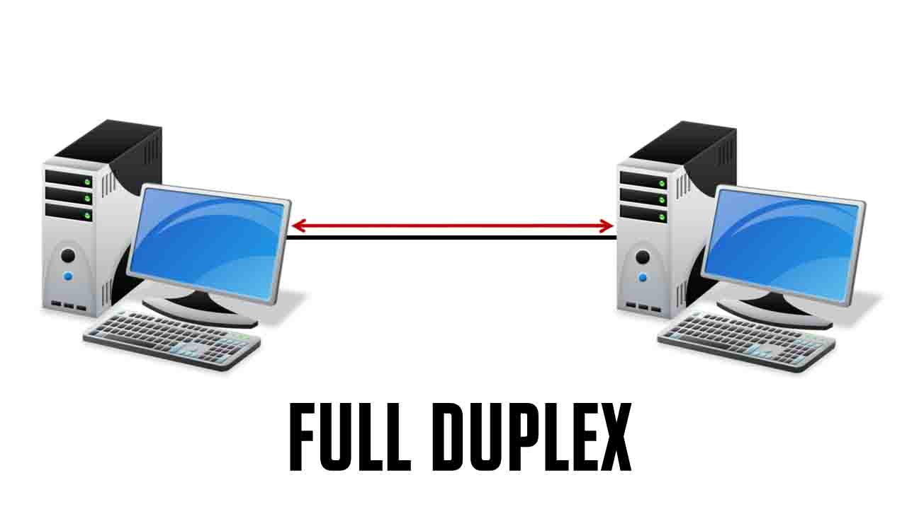
Modes of Data Communication

Slide 20
Modes of Data Communication
Advantage of Full Duplex.
· Enables two-way communication simultaneously.
Disadvantage of Full Duplex.
· The most expensive method in terms of equipment because of two bandwidth channels is required

